Slide 1
Introduction to Access
Quick Access Query

Slide 2

Just Remember, I’m Watching You!

Slide 3
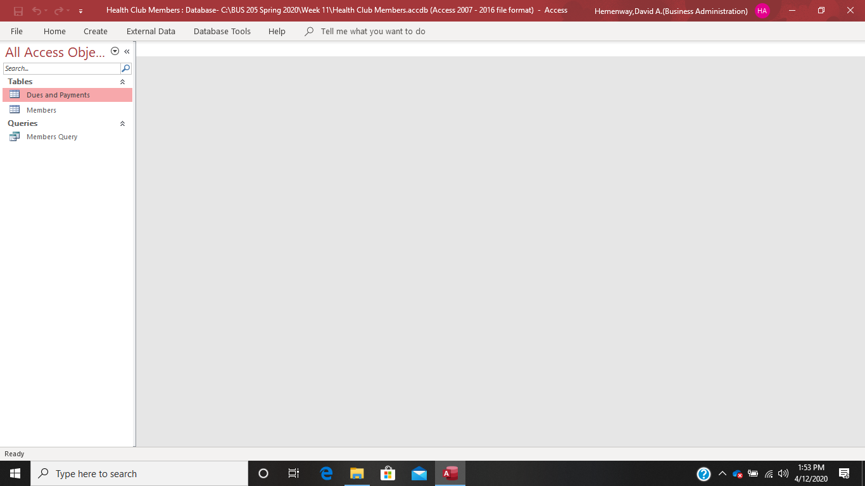
Open your Health Club Members Access Database. Your screen should look like this:

Slide 4
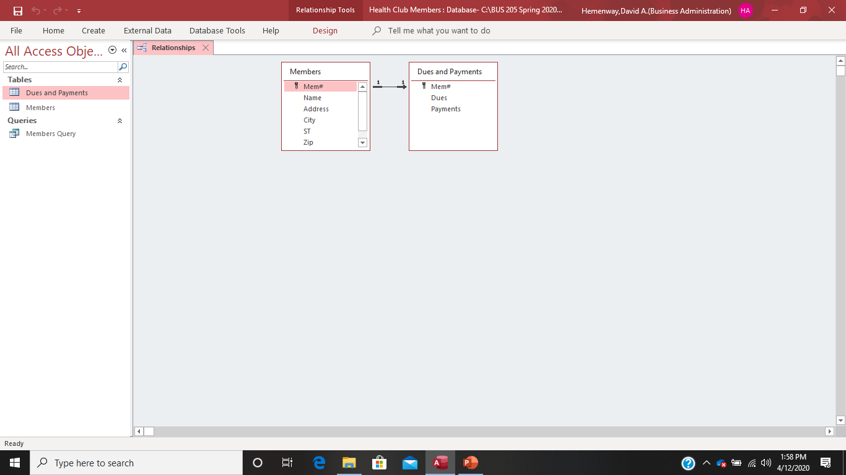
Verify that the relationships are correct:

Slide 5
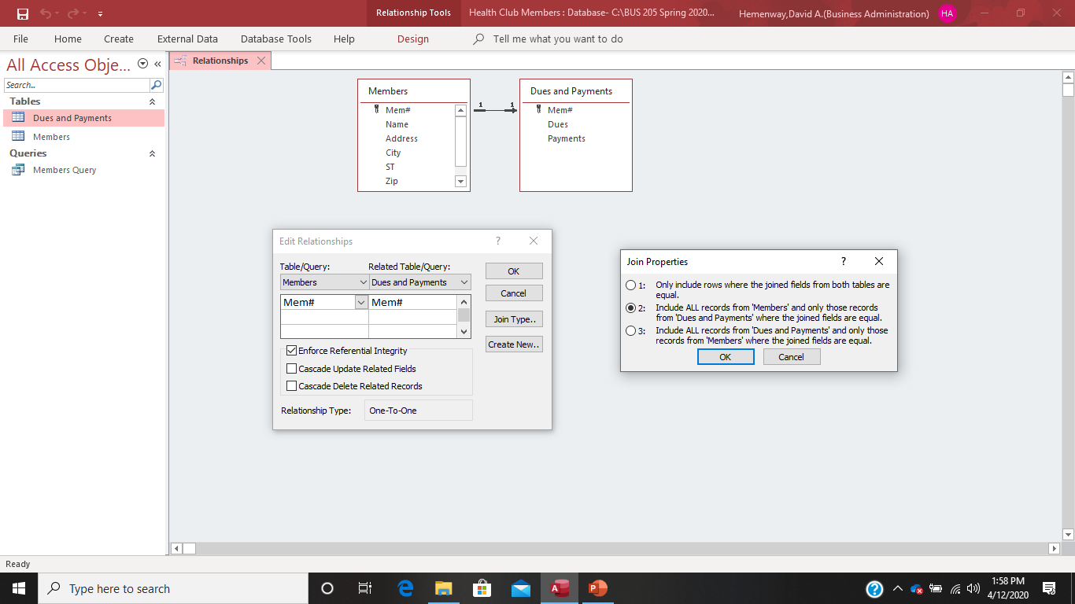
Put your cursor EXACTLY in the middle of the join line and right click to see the relationship between the Members and Dues and Payments tables. Enforce Referential Integrity should be selected. The Join Properties should be #2. Close the relationships screen.

Slide 6
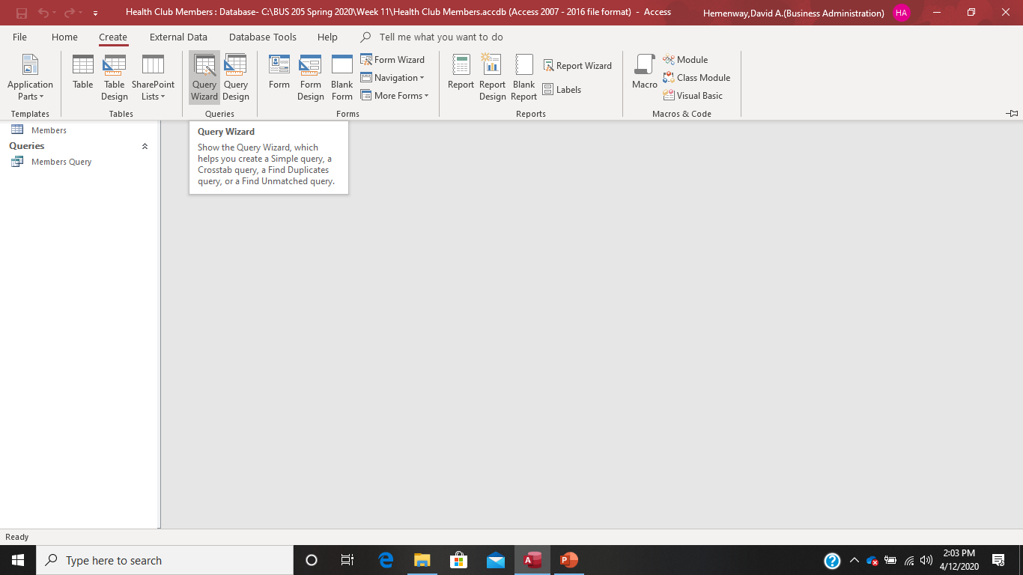
Open the Query Wizard screen by selecting Create, Query Wizard options:

Slide 7
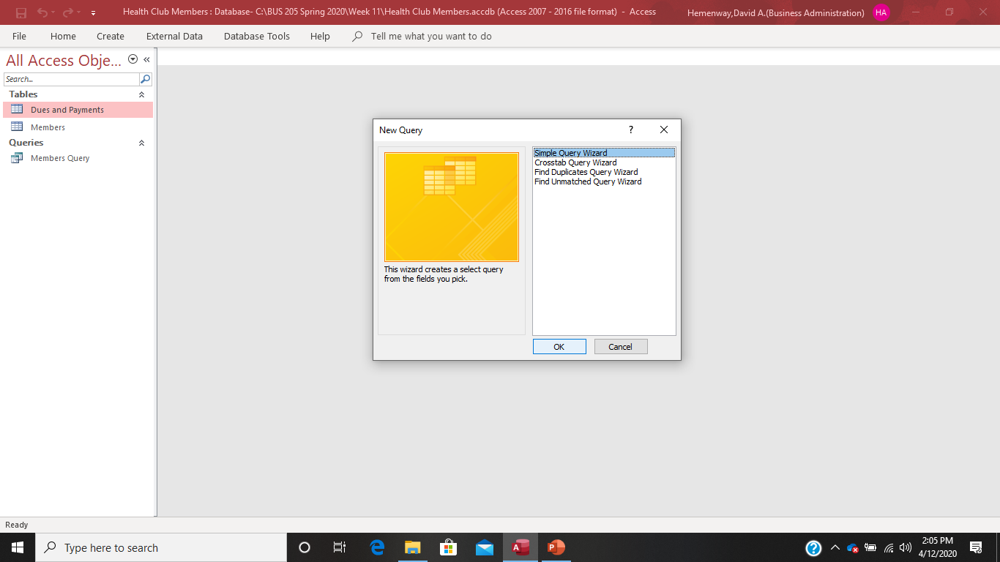
Select Simple Query Wizard and hit OK

Slide 8
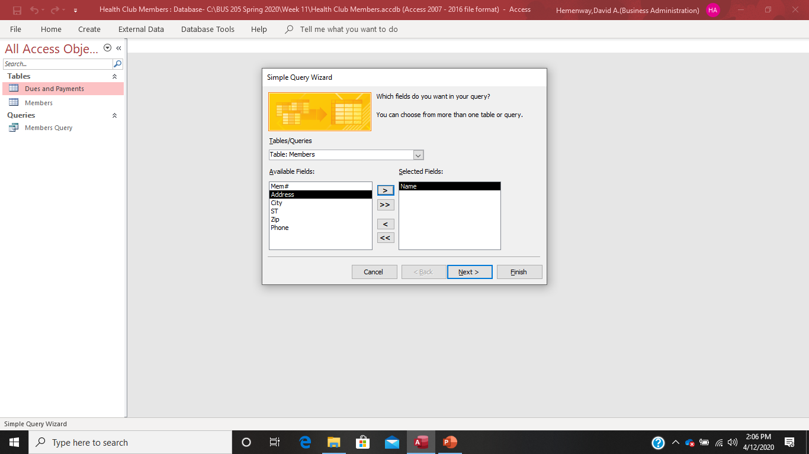
Select the table Members and move Name to the Selected Fields and then go up to the Tables/Queries menu, select table Dues and Payments, and select the variables (fields) Dues and Payments.

Slide 9
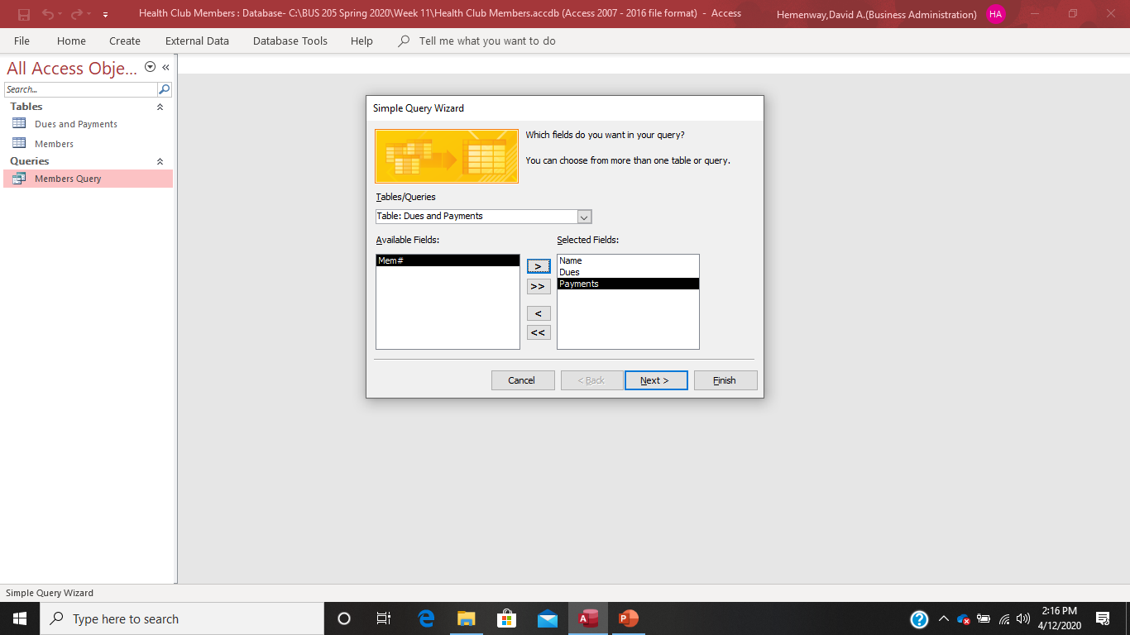

Slide 10
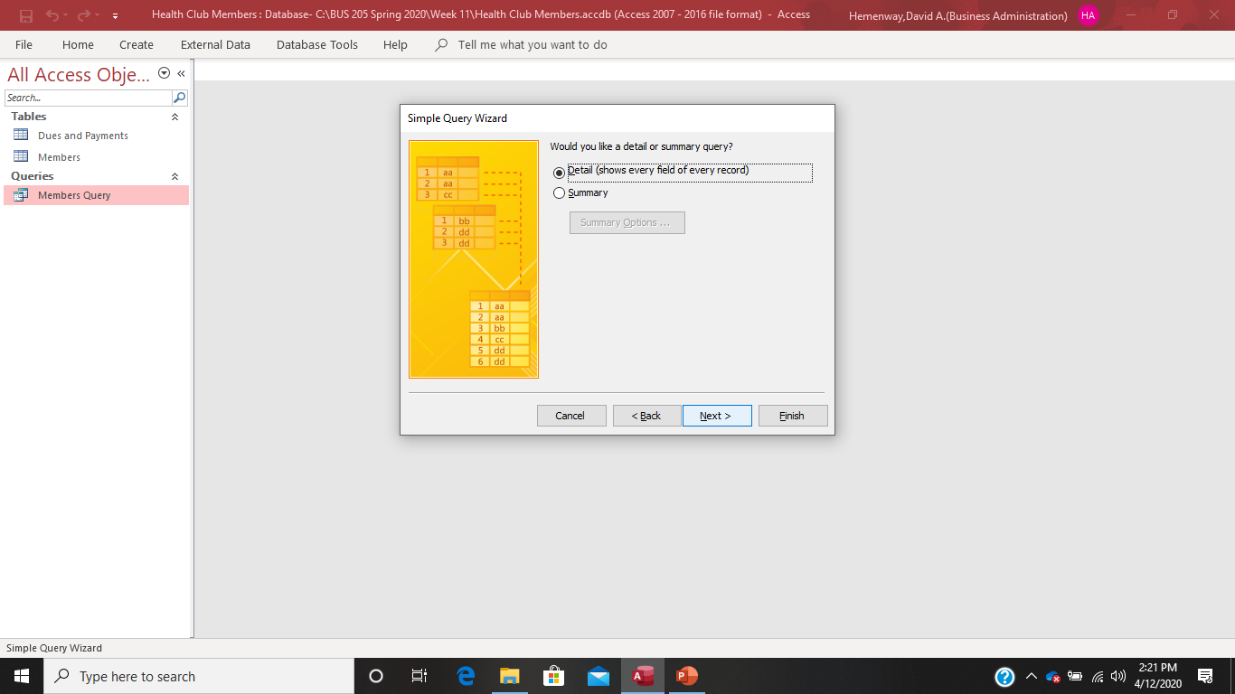
Select the Detail (shows every field of every record) and select the Finish option

Slide 11
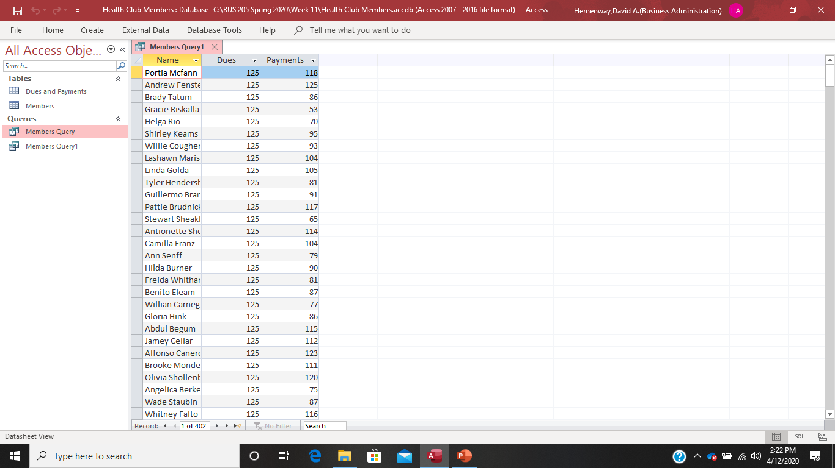
Your results should look like this:

Slide 12
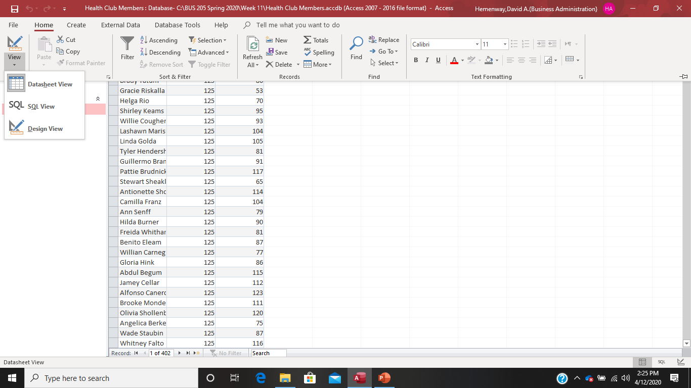
Now let’s check out some different views of this simple query! This is the Datasheet View:

Slide 13
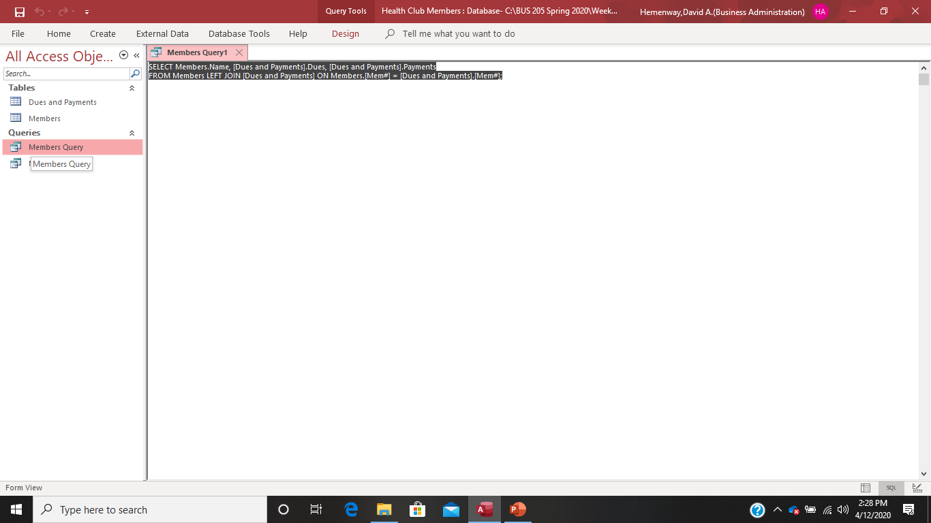
Now let’s check out some different views of this simple query! This is the SQL View:

Slide 14
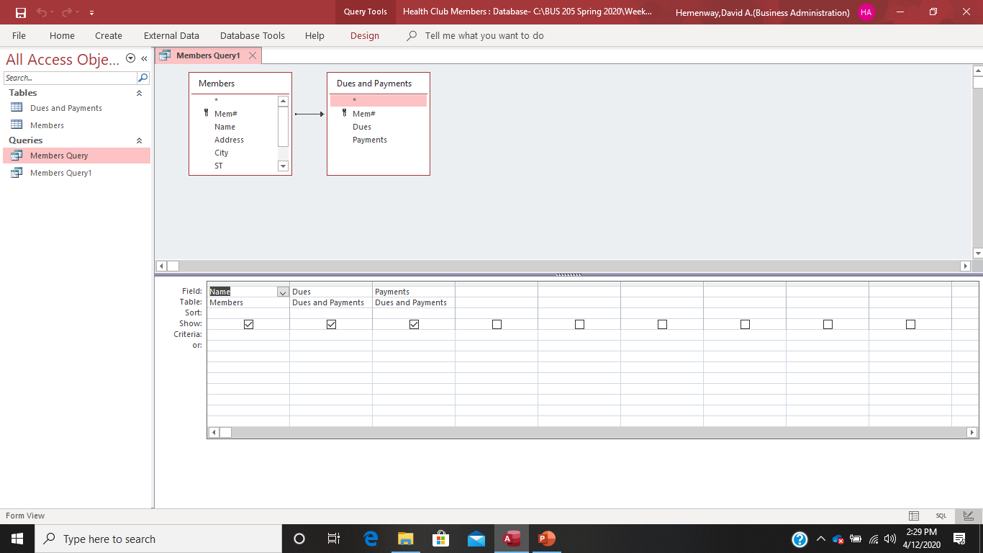
Now let’s check out some different views of this simple query! This is the Design View:

Slide 15
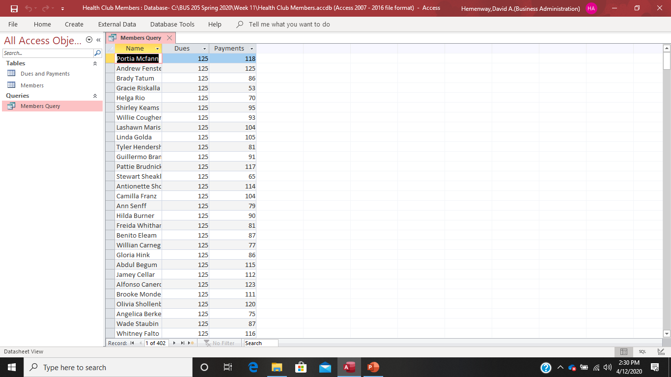
Now let’s go back to the Datasheet View so we can review our query results:

Slide 16
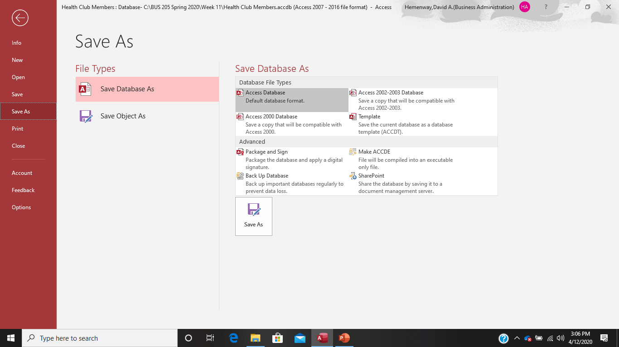
It is a good idea, no great idea, to save your Access file now!

Slide 17
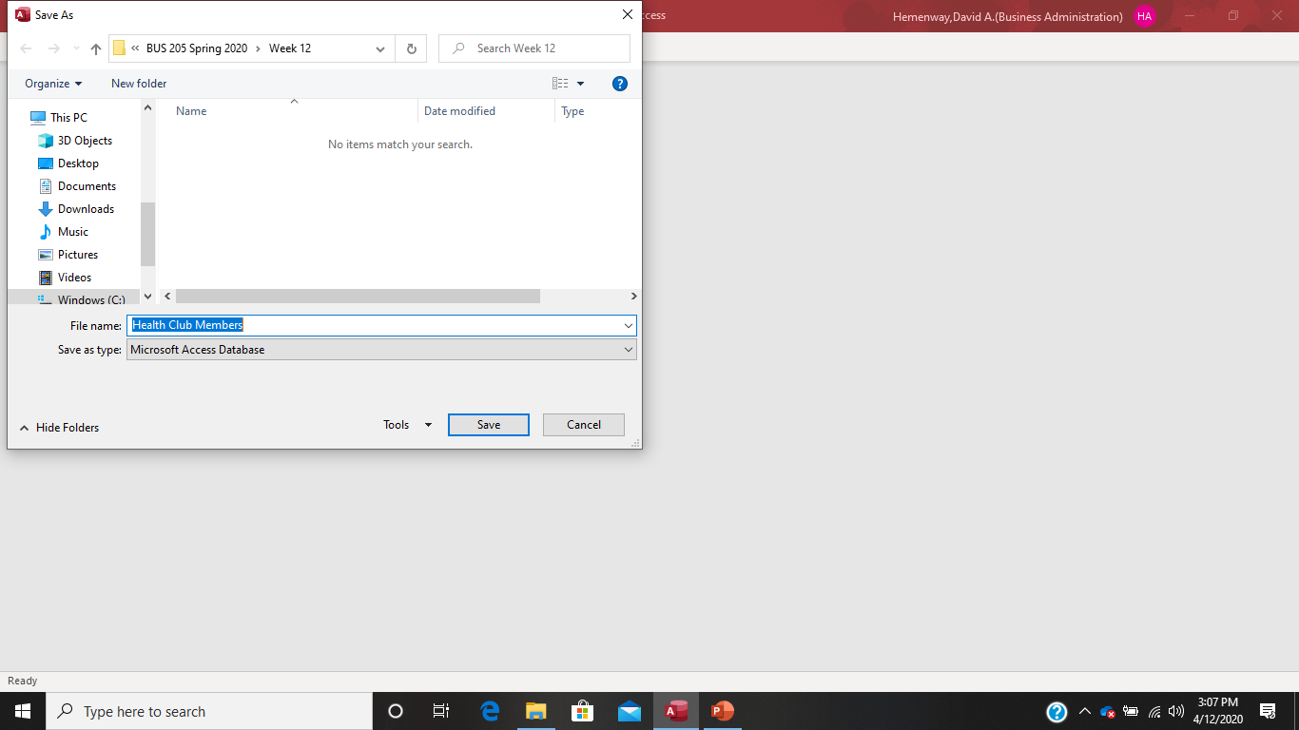
Choose where you want to put your Access Health Club Members Database and select Save

Slide 18

Select Yes to this:

Slide 19
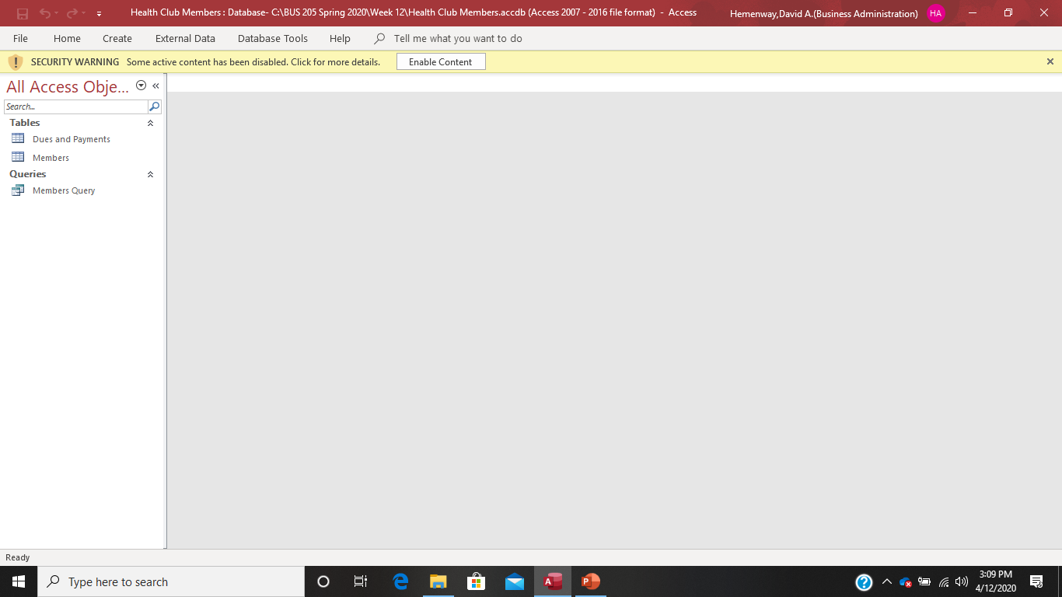
If you get this message, select Enable Content

Slide 20
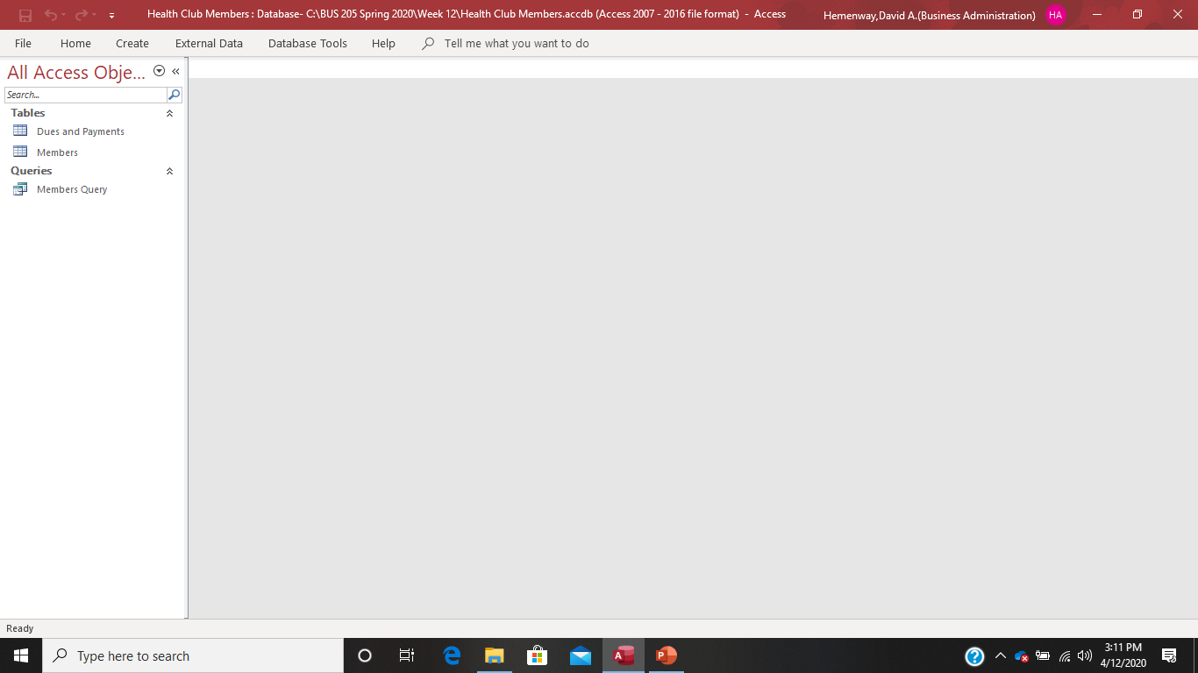
Your Access screen should now look like this:

Slide 21

Open your query by double clicking on your Members Query

Slide 22
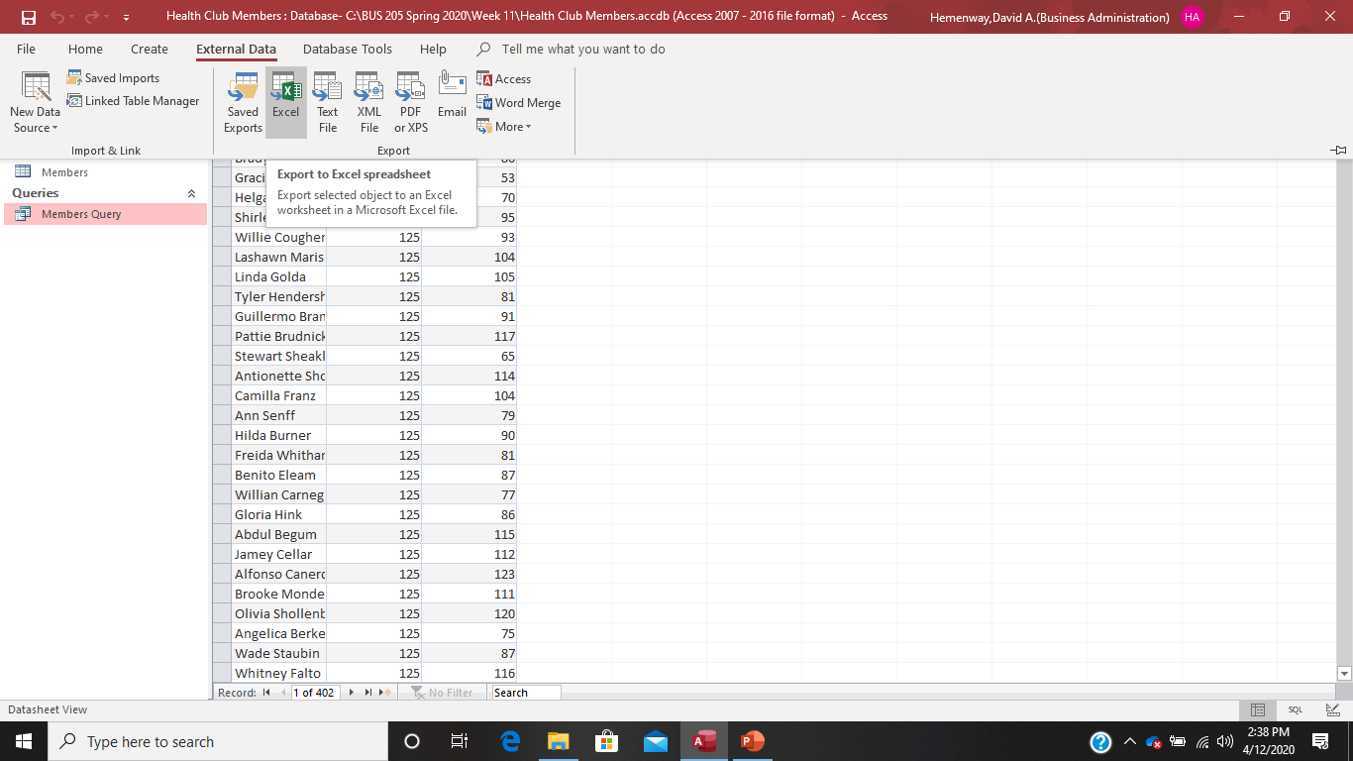
As you have probably guessed by now, I think this report is UGLY and simply unacceptable! So let’s make it nice in Excel! Select External Data and to Excel

Slide 23
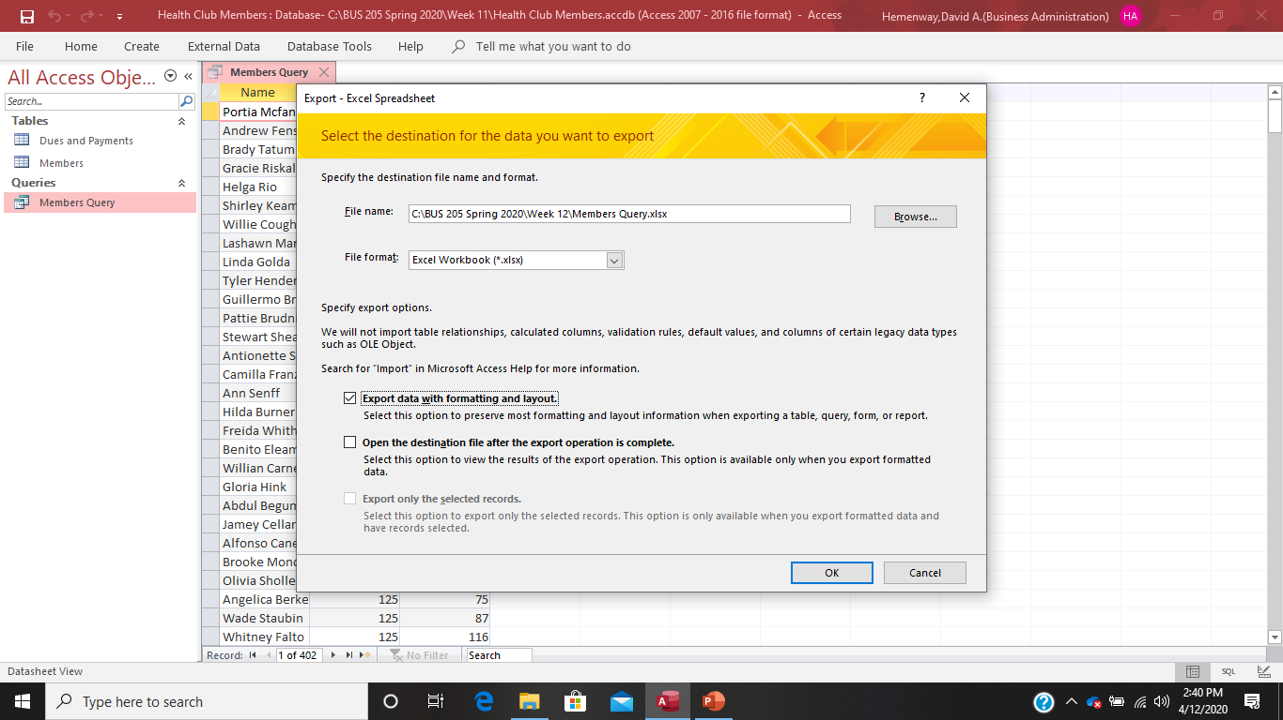
Select where you want to save your Excel spreadsheet using the Browse option and specify Export data with formatting and layout. Select the OK button.

Slide 24
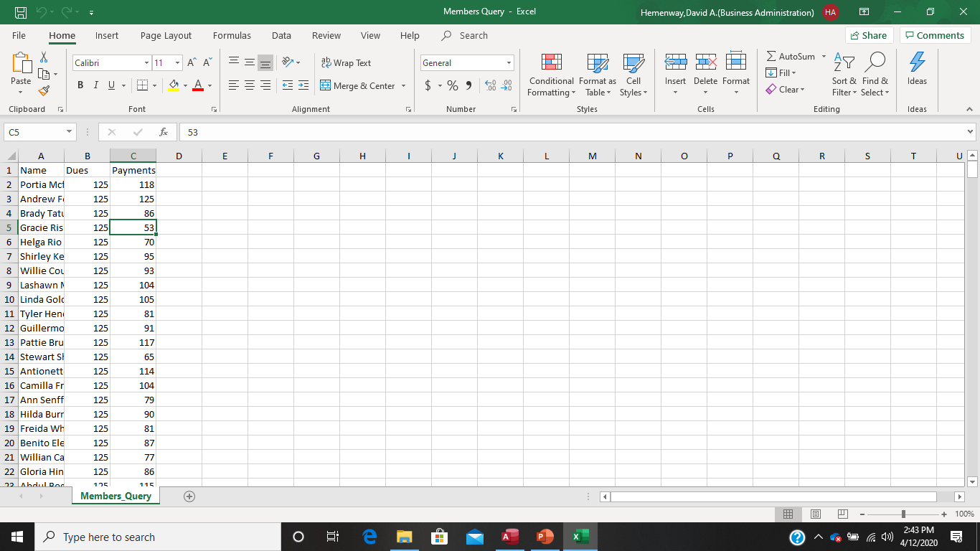
Browse over to wherever you saved the Excel spreadsheet. It should look like this:

Slide 25
Do the following to your Excel Spreadsheet:
Widen the columns
Put a blank row between the first and second rows
Center the Dues and Payments columns
Change the format of the Dues and Payments columns to currency with a $ sign and a comma between thousands
Go to row 406 and make a Total for the Dues and Payments columns using the appropriate statistical functions
Got to row 407 and make an Average for the Dues and Payments columns using the appropriate statistical functions

Slide 26
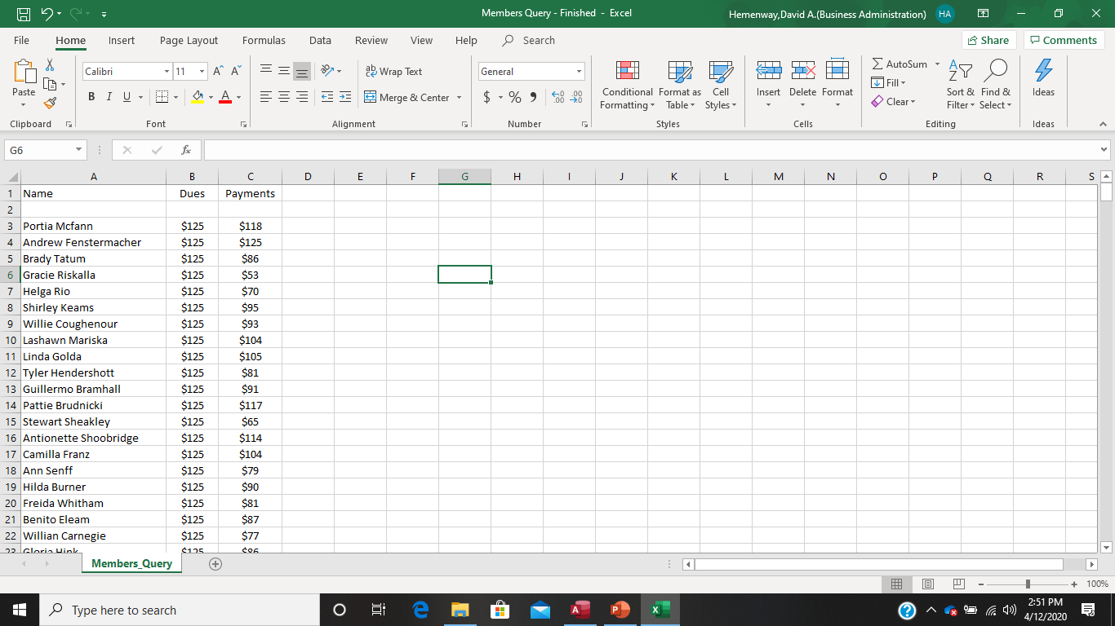
The top part of your Excel spreadsheet should look like this:

Slide 27
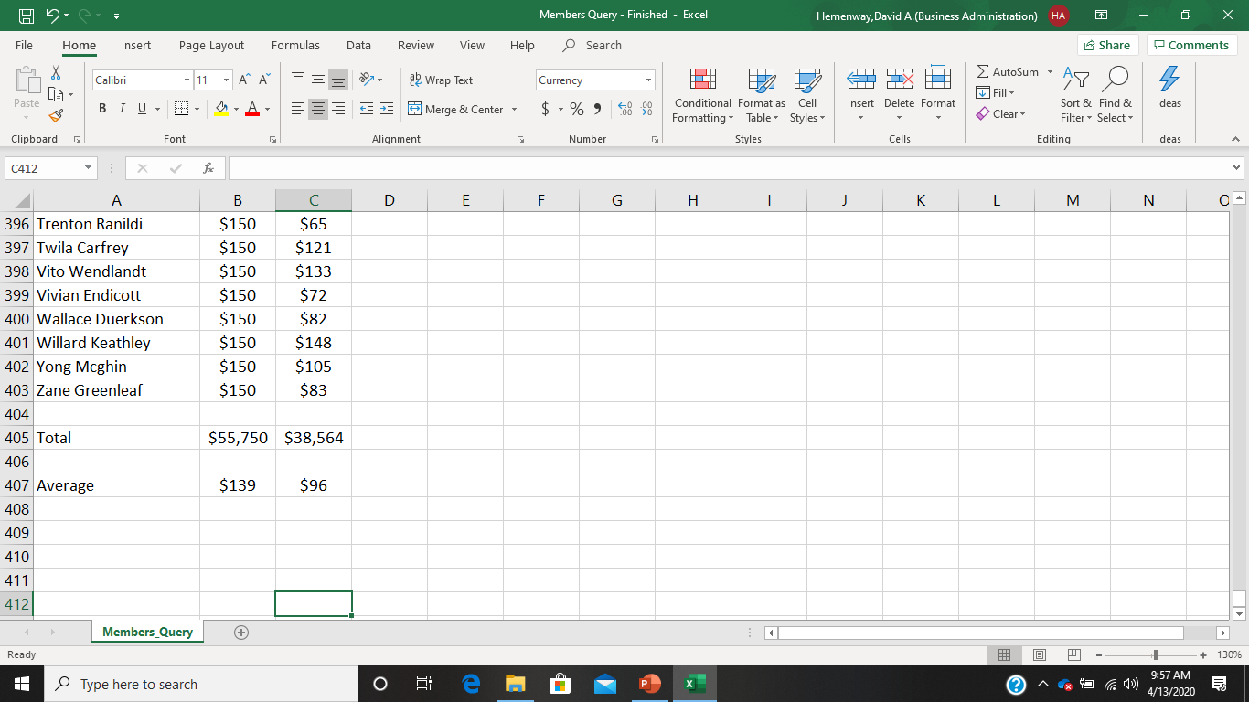
The bottom part of your Excel spreadsheet should look like this:

Slide 28

Now doesn’t your Excel spreadsheet look much more professional than the original Access query report? Cappy thinks so!

